Slide 1
Fundraising Rooted in Racial Justice:
Transitioning Crisis Donors to Mission Donors
Lejla Bajgorić, Douglas Manigault III, and Regina M. Sharma
Notes:
Sunday, April 16 at 10:45AM - 12:00PM

Slide 2
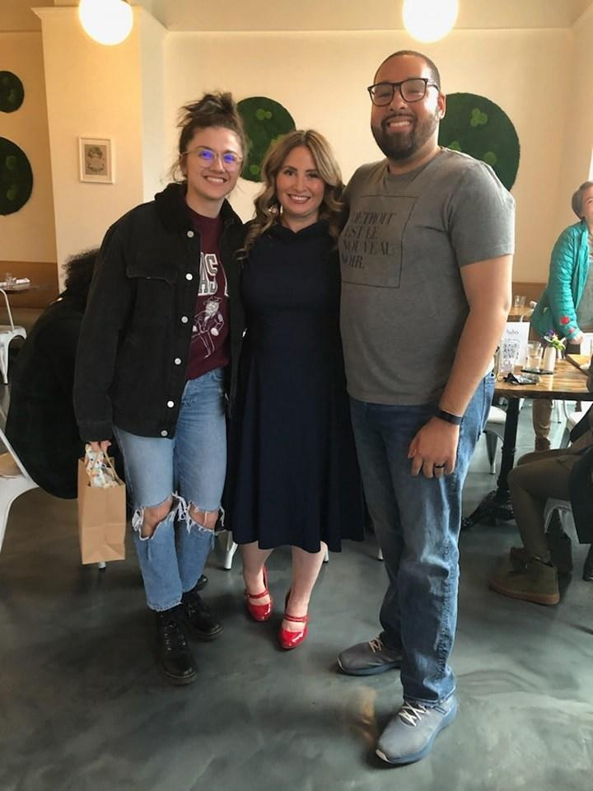
Welcome fundraising colleagues!
About Us
Lejla Bajgorić (she/her)
Associate Director of Development, Detroit Justice Center (DJC)
Douglas Manigault III, MSW, CFRE (he/him)
Chief Development Officer, The Corner Health Center
Regina M. Sharma, MPA (she/her)
Development Director, Detroit Justice Center (DJC)
Notes:
5 minutes
Lejla: Welcome to Fundraising Rooted in Racial Justice: Transitioning Crisis Donors to Mission Donors! My name is Lejla Bajgorić. I use she/her pronouns and I am the Associate Director of Development at the Detroit Justice Center. My background is primarily in arts & culture and anti-racism social justice spaces in the greater Detroit area. I have a personal passion for the role fundraising can play in mobilizing community and building power for grassroots movements, and I’m excited to be here with you all today.
Douglas: Greetings everyone. I am Douglas Manigault III. I use he/him pronouns and I am the Chief Development Officer at The Corner Health Center. I am also a Lecturer at the University of Michigan School of Social Work, where I teach grant writing and fundraising, program evaluation and applied research, as well as theories of community change. I have spent the last nearly 10 years in fundraising roles that help support several missions, including human services, community mental health, racial justice, and politics / government. The last several years, I have focused on movement-based fundraising, including as a former fundraising professional at the Detroit Justice Center. I am honored to be back with this amazing team to share with y’all today.
Regina: Good Morning everyone. I am Regina Sharma. I use she/her pronouns and I am the founding Director of Development at the Detroit Justice Center.
It is such a pleasure to be here in community with all of you today as development colleagues committed to investment in our missions as individual organizations & as a sector. I have always found AFP ICON to be a really enriching experience - not just in our time together in sessions - but also in our time in between - sharing ideas and so I hope that, if not in our short time together today, we have an opportunity to connect at some point this week.
A little about me - I’m a very proud Detroiter and I have been very fortunate to build a career focused on fundraising for organizations that I see as playing a critical role in improving the quality of life for all Detroiters. I began my career about 20 years ago first working in youth and economic development, helping to launch a k-12 ed foundation for the Detroit Public Schools and then I spent about a decade working in higher education and healthcare before joining the Detroit Justice Center two years ago as our first Development Director.
We are so delighted to share with you all today what we’ve been able to accomplish fundraising in ways that truly aligned with our own values.

Slide 3
Overview
Introduction
Centering exercise
Organizational background/history of crisis donor acquisition
Building an internal culture of philanthropy rooted in stewardship
Development of annual, sustaining & leadership giving programs
Communication & capitalizing on impact
What happens when a new crisis emerges and how does your organization respond?
Group activity
Final thoughts/Q&A
Notes:
Douglas: Overview

Slide 4
Centering us in Community
Word Cloud Exercise
What inspired you to choose this session?
What crisis has your organization experienced?
What was the impact of the crisis on your organization?

Slide 5
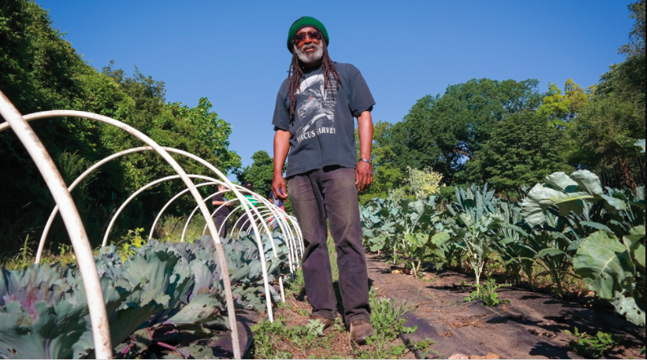
We are a non-profit law firm working alongside communities to create economic opportunities, transform the justice system, and promote equitable and just cities.
Notes:
30 seconds
Regina: So beginning with some background on our organization, the Detroit Justice Center is a community-based, racial justice-centered nonprofit law firm and we are guided by the belief that we cannot build truly just cities that work for everyone without addressing issues of mass incarceration. We do this work through a three-pronged approach we call defense, offense and dreaming.

Slide 6
Notes:
2 minutes
Lejla: The defensive prong of our work is where we address fees, fines, warrants - all of the things that are keeping Detroiters shut out of the economy. Then we go on offense with our Economic Equity Practice. This is where we are shoring up all of the incredible freedom dreams that Detroiters have been coming up with for decades - things like worker owned cooperatives & community land trusts that will keep that land in people's hands for generations to come. And the final prong of our work is our dreaming approach - our Just Cities Lab - and that is where we are piloting alternatives to punitive justice that are replicable across the country.

Slide 7
2020 Racial Uprisings
National spotlight on racial justice organizations
Lacking development infrastructure as a start-up nonprofit law firm
Growth from 400 donors to nearly 20,000
Notes:
Regina: The Detroit Justice Center was founded in 2018 on the belief that it’s not enough to just talk about what we’re tearing down in terms of mass incarceration, but that’s is just as important to talk about what we’re building up and what we’re building up is a just city - investing in our community by piloting real solutions to community safety that address root causes of harm with our divest/invest work and our Metro Detroit Restorative Justice Network. Fast forward to two years after our founding to June of 2020 and suddenly, an enormous nat’l spotlight had been placed on racial justice organizations. Locally in Detroit, we were the only organization with a revolving bail fund. In conjunction with community partners, we were filing lawsuits on behalf of protestors who were being arrested during the uprisings. As COVID was raging in the jails, we were fighting to get community members released and back at home with their families.
At that time as a start-up nonprofit law firm with only a few staff, DJC had next to no development infrastructure, our ED was writing most of our grants. A modest number of individual donations were coming in from friends and family members of our staff and we had one part-time staff member who was managing thank you letters and receipting.
And suddenly, as racial justice orgs were boosted to the top of national attention, donations were coming in from all across the country. In a 2-month period of time, Detroit Justice Center went from an organization with just a few hundred individual donors to nearly 20,000.

Slide 8
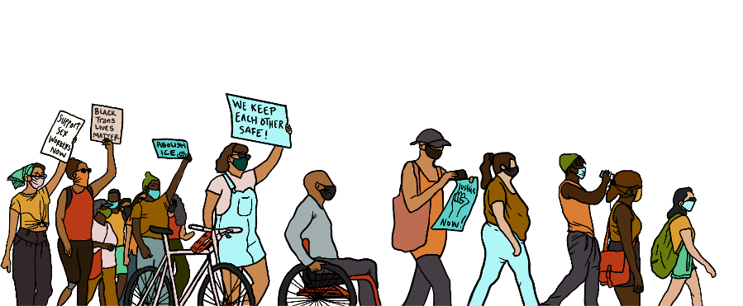
Our Guiding Question
What drives donors to invest in a movement?
Image: Third Wave Fund
Notes:
Regina: Donors from across the world were responding to racial injustice. But, the question for us and the driving question we’d like to unpack with you all together today is what shifts donors from crisis response to a long-term investment in a movement?

Slide 9
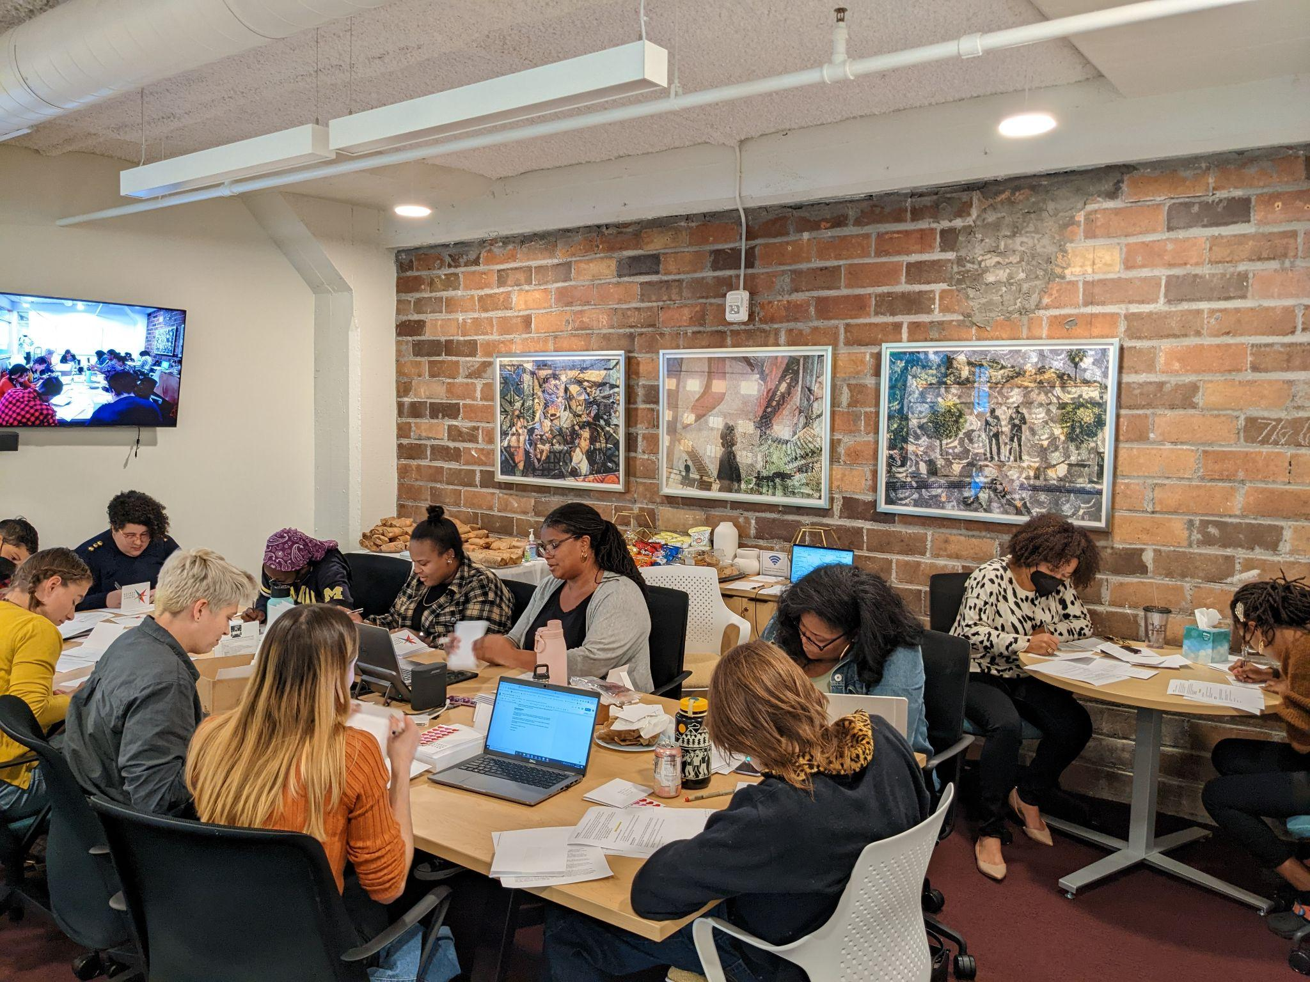
Culture and Stewardship First!
Imbedding stewardship into building an internal culture of philanthropy
Thank-a-thon
Staff participation
2021: 60%
2022: 85%
Notes:
Douglas: DJC’s leadership was both excited and overwhelmed with our new “opportunity:” 20,000 donors. Talk about the ultimate opportunity! But what we all know is that without a strong fundraising strategy, we would run the risk of losing almost all of those donors. That’s where the vision to hire the first Development Director came from.
DJC was looking for someone like Regina who had been intentional in their career choices in prioritizing fundraising for organizations that are Black and Brown-led and advocating for representation being a crucial component of how we serve our communities.
Wallah! We have Regina come on-board as our first Development Director in March 2021, and her first three priorities were:
Building out our development department (we will talk about this a little later in the presentation)
Developing a Gift Acceptance Policy (shameless plug - we talk about this tomorrow morning at 8AM) and
Imbedding stewardship into building an internal culture of philanthropy (which is what we will share more about now).
We had this enormous donor acquisition and no one had intentionally thanked these donors. No one had picked up the phone and said thank you so much for your generosity and this is what we have been able to accomplish with your partnership and investment. At the same time, we were navigating the demographics of the folks working at our nonprofit law firm. For many of our colleagues who are also attorneys, this was the first time they had ever worked at a nonprofit, so instilling a culture of philanthropy was critically important - partnering with them to understand donor engagement and speaking about our work in a way that leads with impact was the task at hand.
Lejla: And the result of our desire to combine stewardship with building our internal culture of philanthropy was DJC’s first ever Thank-a-thon in the summer of 2021 - asking every staff member at DJC to pick up the phone or write thank you cards and thank donors. The results of this were tremendous: We were able call and send thank you letters to hundreds of donors, and send every donor a stewardship email, summarizing the impact of what we achieved in the last year with their support. Out of a team of 30 employees, primarily attorneys, 60 percent of our staff participated. And we’ve kept that tradition going and in 2022, pictured on this slide, we had even greater success with results including 400 donors thanked and a turnout of 85 percent of our team.

Slide 10
Strategy for Long-Term Investment
Develop an Annual Giving communications strategy rooted in our values
Build a Sustaining Giving Program
Prioritize a Leadership & Major Giving Program
Notes:
Regina: After we had begun to implement a stewardship strategy including building our internal culture of philanthropy, we then began developing our annual giving & communications strategy, looking at what does leadership & major giving look like for DJC, and building a sustaining giving program.

Slide 11
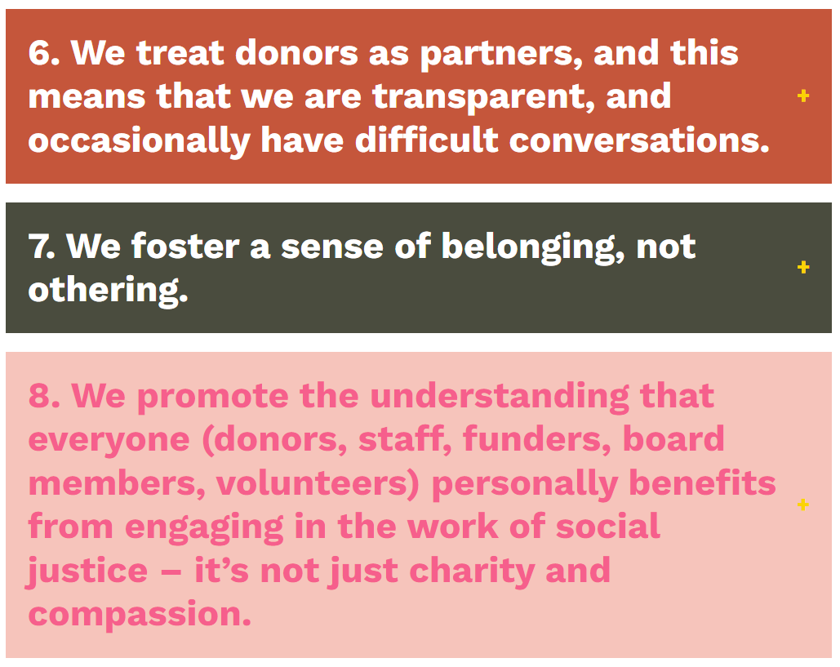
Annual Giving Communications Strategy
Source: Community Centric Fundraising
Notes:
Lejla: For our annual giving comms strategy, a great segment of these new donors were individuals who saw the police repression that was happening on the streets and they wanted to help–they didn’t want to sit on the sidelines. We used community centric fundraising principles to make sure our messaging during this time (and moving forward) didn’t reinforce notions of saviourism or tokenism, and instead communicated how gifts in solidarity with our struggle helped us build a new world where everyone had greater access to true safety.
Lejla to make CCF part more explicitly connected to racial justice

Slide 12
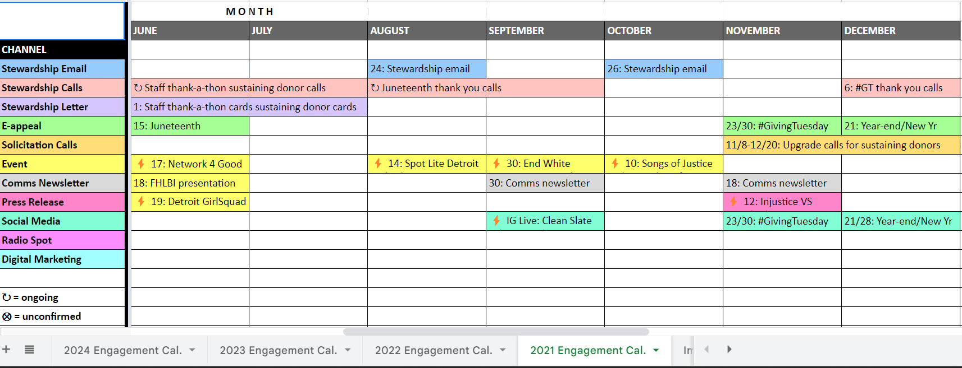
Annual Giving Communications Strategy
Notes:
Lejla: Our strategy that year focused on setting in place a bi-monthly stewardship newsletter cadence that communicated impact updates, gratitude, and shared engagement opportunities when possible.
We then began working on our sustaining giving strategy. Of the large donor acquisition we had in 2020, 490 of them had actually signed up to become sustaining donors which means they were still crisis donors in that they responded to the crisis through their philanthropy, but they already understood that the organization would need to organize beyond the crisis and sort of pioneered this trajectory of deeper investment that we were hoping to replicate with the rest of our one time donors. We knew that starting our heaviest investment with this group of engaged donors would not only increase our connection to them, but could also help build momentum to continue to further engage with those one-time crisis donors.
(Internal note for team: If we’re asked, half–or 250–of those who signed up for sustaining giving in the summer of 2020 still have active plans).

Slide 13
Sustaining Giving Program: Design
Name
Tagline
Logo
Mission centered offerings
Notes:
Lejla: So our first step in doing this was establishing an identity for the sustaining giving program because we wanted our sustaining donors to truly feel as though they were part of a community–a special group of highly committed members of our movement, because that’s exactly what they are!
A unique identity for the program required a list of things, including a name that felt personal to our work and communicated the specific impact sustaining grassroots support makes possible. Deciding on the name was another great opportunity to deepen staff engagement and continue building a culture of philanthropy, so we held a brainstorming session with staff and invited them to vote on their favorite ideas. We ended up calling our program DJC’s Freedom Dream Sustainers with the tagline: Ongoing support from folks like you allows us to spend less time fundraising and more time going after our wildest freedom dreams, knowing that we have a solid base of community supporters in our corner.
Our logo is meant to evoke the same sentiment–the bird in our logo features the same colors and almost looks like our organizational logo is taking flight. Lastly, we focused on identifying program offerings that were rooted in engagement and brought our donors closer to our mission and into our movement.

Slide 14
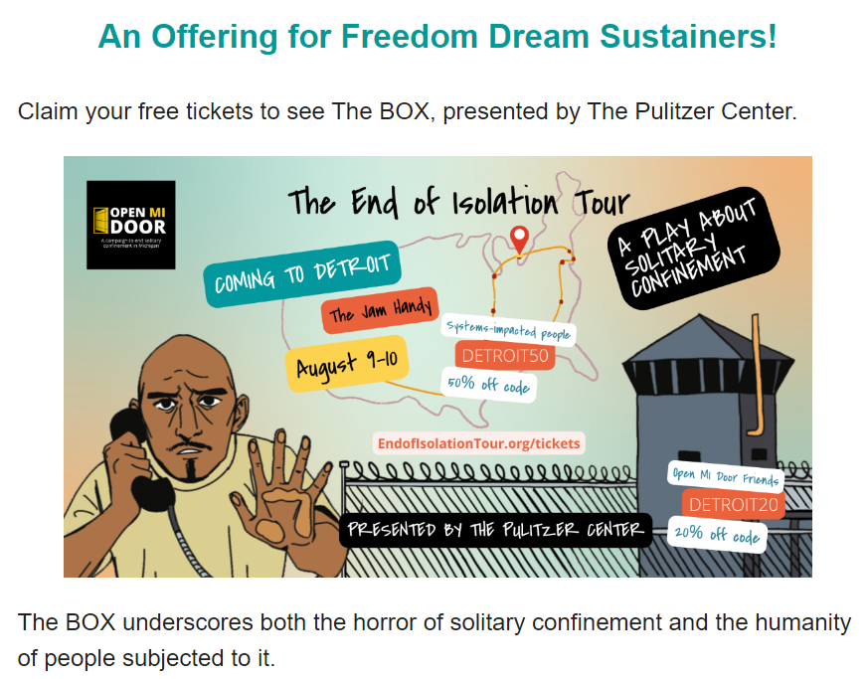
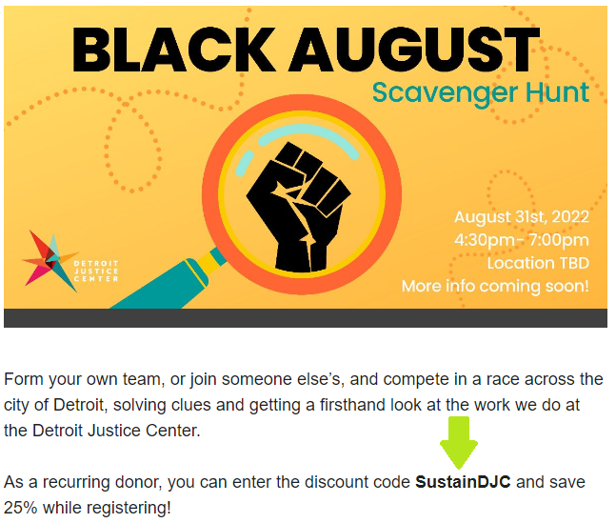
Sustaining Giving Program: Engagement
Notes:
Lejla: So opportunities to learn more about the impacts of mass incarceration, including trainings and artistic experiences organized by our community partners. Discounted entry at fundraising events that also functioned as ways to meet our team and get a firsthand look at our work. First dibs on volunteer service opportunities, so on and so forth.
As you can probably tell, we weren’t taking for granted that even our sustaining donors came on in the midst of a crisis and that we needed to convert them to mission donors as well.

Slide 15
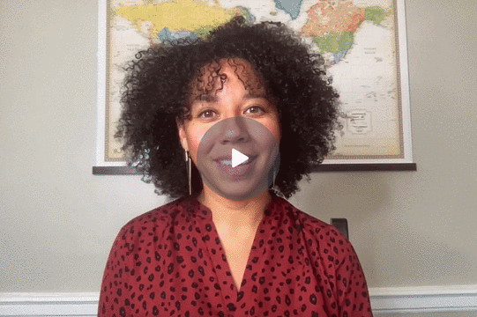
Sustaining Giving Program: Launch
Welcome package
letter
impact report
giveaways
Celebrating founding members
Welcome campaign e-series
Notes:
Lejla: When it came time to announce the program, as an extra bit of stewardship, we honored our existing sustainers as our “founding members” since they already had active giving plans.
Our ED recorded a welcome video that would would serve as the kickoff to a larger welcome email series, officially launching the program and giving donors a chance to hear directly from the ED on the importance of their giving. The email series also included an impact story and a survey in the final week, giving us a chance to learn more about the donors’ interests and engagement preferences. It concluded with a mailed welcome package that included a copy of our impact report.
Any new sustaining donors now also go through this same stewardship plan, but for our founding members, it was really a point of celebration and excitement around the launch of the program.

Slide 16
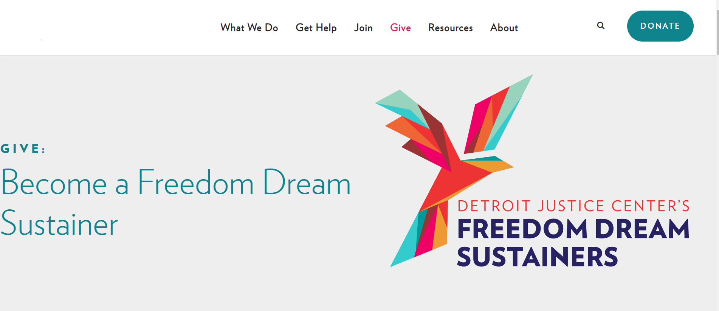
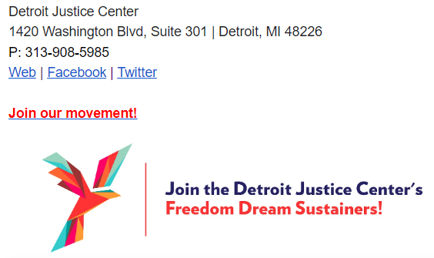
Sustaining Giving Program: Visibility
Notes:
Lejla: Lastly, we spent time ensuring the program was visible and prominent to build up its familiarity within our network. This included building a custom webpage for the program, featuring it on our social media channels–most prominently Instagram, and having each member of our staff include a call to action to join the program in their email signatures. We also began extending personal solicitations/invitations and growing our outreach. This was all in preparation for what would come next…

Slide 17
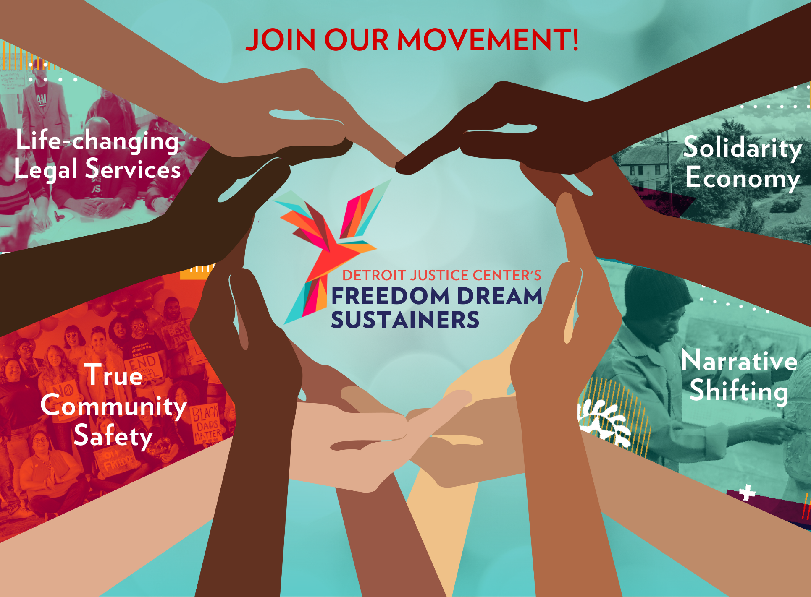
Sustaining Giving Membership Drive
Notes:
Lejla: A membership drive. Now, aside from the need to convert even our crisis sustaining donors into true mission donors, the big reason we’ve dedicated such a large chunk of our presentation to our sustaining giving program is because leveraging the identity and visibility of the program through a membership drive was our #1 most successful tactic in winning back those lapsed crisis donors.

Slide 18
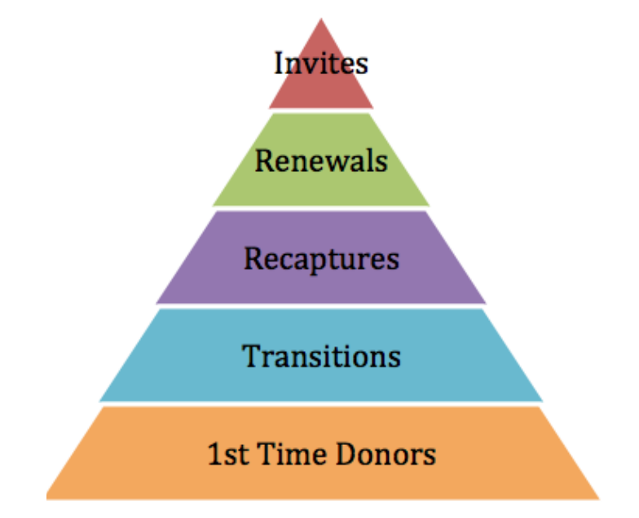
Sustaining Giving Membership Drive
Retention: 40% .
Recapture: 20% .
Acquisition: 2% .
Source: Little Green Light
Notes:
Douglas: Going into the membership drive, we had very different expectations. Our prediction, as data would show, was that:
The likelihood of acquiring a brand-new donor from a general list is below 2%.
The likelihood of recapturing a lapsed donor who didn’t give at all last year is lower, around 20%
And the likelihood of year-over-year retention for renewals–donors we’re asking to renew their giving–is around 40%.
As a result, we dedicated most of our energy into the renewal group–donors who had already given that year or made a gift in the last year. Not only did they receive our e-solicitations, but they also received phone calls, in some cases letters and even a copy of our impact report. For our recaptures, our lapsed crisis donors, we didn’t invest as heavily and primarily targeted them through email and social media.
Confirm with RS & DFMIII that an annual campaign pyramid makes sense to include here.

Slide 19
Sustaining Giving Membership Drive
Notes:
Douglas: However, those digital communications were still segmented and strategic–we spoke directly to the crisis that prompted so many of them to give in the first place and shared testimonials of donors like them who took the next step and continued to support our work year after year. We framed the program as the vehicle to make the lasting impact they wanted to make with their crisis gifts.

Slide 20
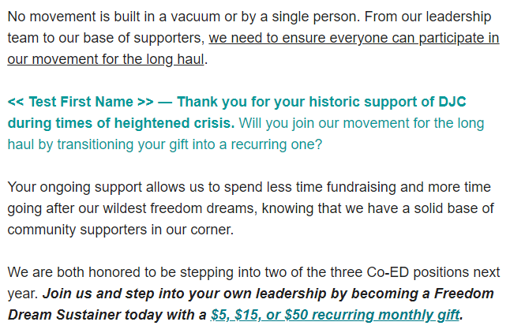
Sustaining Giving Membership Drive
Notes:
Douglas: And we connected the program to the larger movement we’re part of and that many of our donors are part of in different ways. “We need to ensure everyone can participate in our movement for the long haul. Will you join us by transitioning your gift into a recurring one?”

Slide 21
Sustaining Giving Membership Drive
Notes:
Lejla: In the end, almost half–or 42%--of donors who supported our membership drive were those lapsed crisis donors. For context, the membership drive happened almost 2.5 years after the “crisis moment” that led to our mass donor acquisition. Though we didn’t recapture anywhere near the full span of thousands of new supporters from 2020, this experience in particular did revive our hope and provide the affirmation we needed to continue making the effort to reach out to that group, because some of them were still listening, interested, and receptive. We just needed to find the right channels to re-engage them.

Slide 22
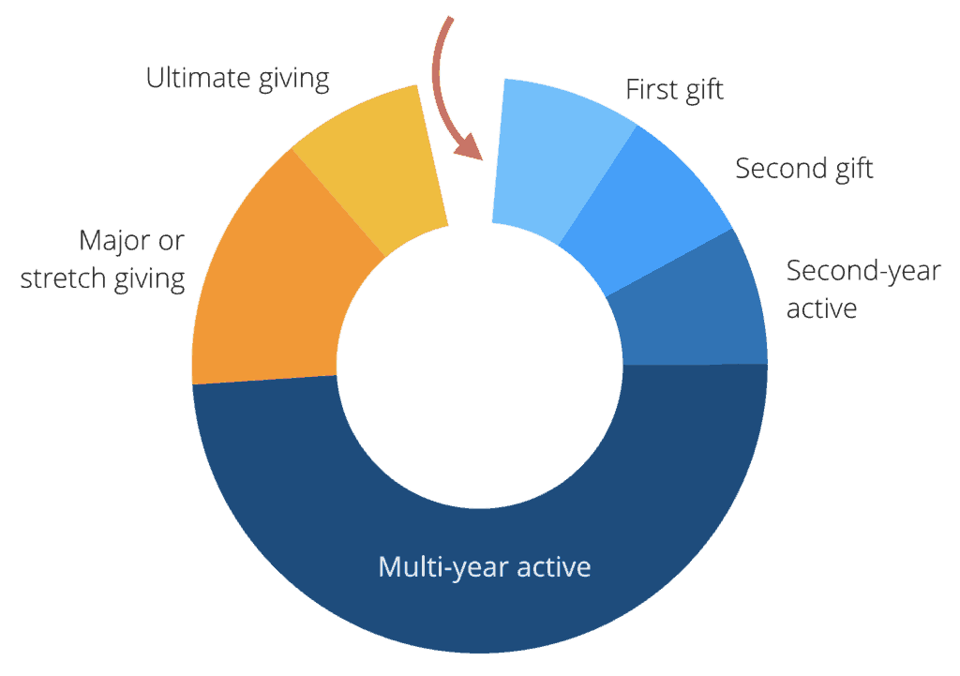
Leadership & Major Giving Program
Hiring a Leadership Gift Officer
Building portfolios
Image: Bloomerang + Kindful (a Bloomerang product)
Notes:
Regina: Building a leadership & major giving program was also a critical part of this process and we relied on what I would describe as some traditional tools to begin building out a program. First, we hired a Leadership Gift Officer with a strategically assigned portfolio based on wealth screening data so that we could begin defining metrics around transitioning some of our “crisis” one-time annual donors in to longer term investors in our work either through becoming sustaining donors or through upgrading their donations.

Slide 23
Leadership & Major Giving Program
Using wealth screening software
Prospect research
Image: iWave
Notes:
Regina: Utilizing wealth screenings and prospect research helped us to confirm our demographics which were that our donors were predominantly gen z and millennial donors. And what we already know about gen Z & millennial donors, as I’m sure you’ve all attended sessions around, if you’re not in that demographic, is that they want to invest in the work in a different way - simply asking for a leadership or major gift isn’t enough. We needed to identify creative ways to engage with them and sustain their support which is why our sustaining giving program, that Lejla talked about, was so crucial to the process.

Slide 24
Two Year Timeline
Hiring a Development Director (March 2021)
Built out the development department, including an Associate Director of Development, Senior Development Associate, and a contract grant writer (April 2021-March 2022)
Stewardship / thank-a-thon (May-July 2021)
Acquisition of wealth screening software (January 2022)
Freedom Dream Sustainers (FDS) launch (March 2022)
Hiring a Leadership Gift Officer (August 2022)
Thank-a-thon #2 (October 2022)
New website launch with FDS page (October 2022)
Development of leadership/major giving portfolios (November 2022)
Notes:
Douglas: Whew! A lot of information, right? Y’all still with us?
Hopefully, the way we have walked through our building, launching, and operating our sustaining giving program, Freedom Dream Sustainers, has been helpful for you. We don’t want you to be overwhelmed with this information – it could easily seem as if we did all the work overnight. In fact, it has taken the better part of the last two years to get this program up and running to truly transition crisis donors to mission donors. On the slide, you will see a snapshot of the milestones over the last two years of how we got where we are today – and we still have a lot more to do. We always do as a fundraiser, which is why we are in demand :)

Slide 25
Understanding the Opportunity
Unpacking the crisis and its impact on your donors
Communicating the impact
Capitalizing on the impact
“Philanthropy is commendable, but it must not cause the philanthropist to overlook the circumstances of economic injustice which make philanthropy necessary.” - Martin Luther King, Jr.
Notes:
I shared earlier in my mini-biography that I teach grant writing and fundraising, so it is fitting me to summarize our presentation with our “theories and practices” that guided - and continue to guide - this work.
Douglas: As we were building this sustaining giving program, we knew we needed to assure we were effectively communicating the crisis (in our case the need for abolition) and it’s impact on our constituents. To communicate the impact, we began imbedding calls to action into our communications: protests donors could attend, petitions they could sign-on to, stances they could take on resolutions and legislation impacting our community and telling stories from our community partners that were rooted in building a world without prisons and policing (utilizing CCF principles - not focused on unethically parading our clients’ stories)
- This is the classic case of philanthropy. We weaved in our work priorities with the national crises - both COVID and the racial uprising - to showcase the importance of our work during the crises. That’s how you capitalize on impact - and, believe it or not, that’s the easy part.
Then, there’s the work to transition crisis donors to mission donors. That requires you to use the winning formula: understand the crisis + how it relates to your work X the need and impact of donor’s support, which attracts crisis donors. You then have to take the crisis donors and add impact statements and multiply that by opportunities to support your work ongoing to get a mission donor.
I want to read this quote for you. I end this slide with this famous quote by Dr. Martin Luther King, Jr. because it rings true for our work and why it is not only our right but our duty to continue to connect donors to our mission for the long-term.
Expert on the content (at least 30,000 foot view) of the work.

Slide 26
Best Practices
Engaging the six (6) ‘rights’ of fundraising
having the right person
asking the right prospective donor
for the right gift
for the right program
at the right time
in the right way
Notes:
Douglas: Our friends over at the Lilly School of Philanthropy provides our sector with so much helpful data and best practices to use in our work, including this beautiful path to cultivation. The six (6) rights of fundraising serve as a guide to our work and a reminder that “our next million dollar donor is already in our database.” We just have to:
-stewardship (thank, thank again, thank and request)
- talk donor retention (as I shared earlier)
-right size who will become longer term donors
-document ROI from donations, including non-solicited donations

Slide 27
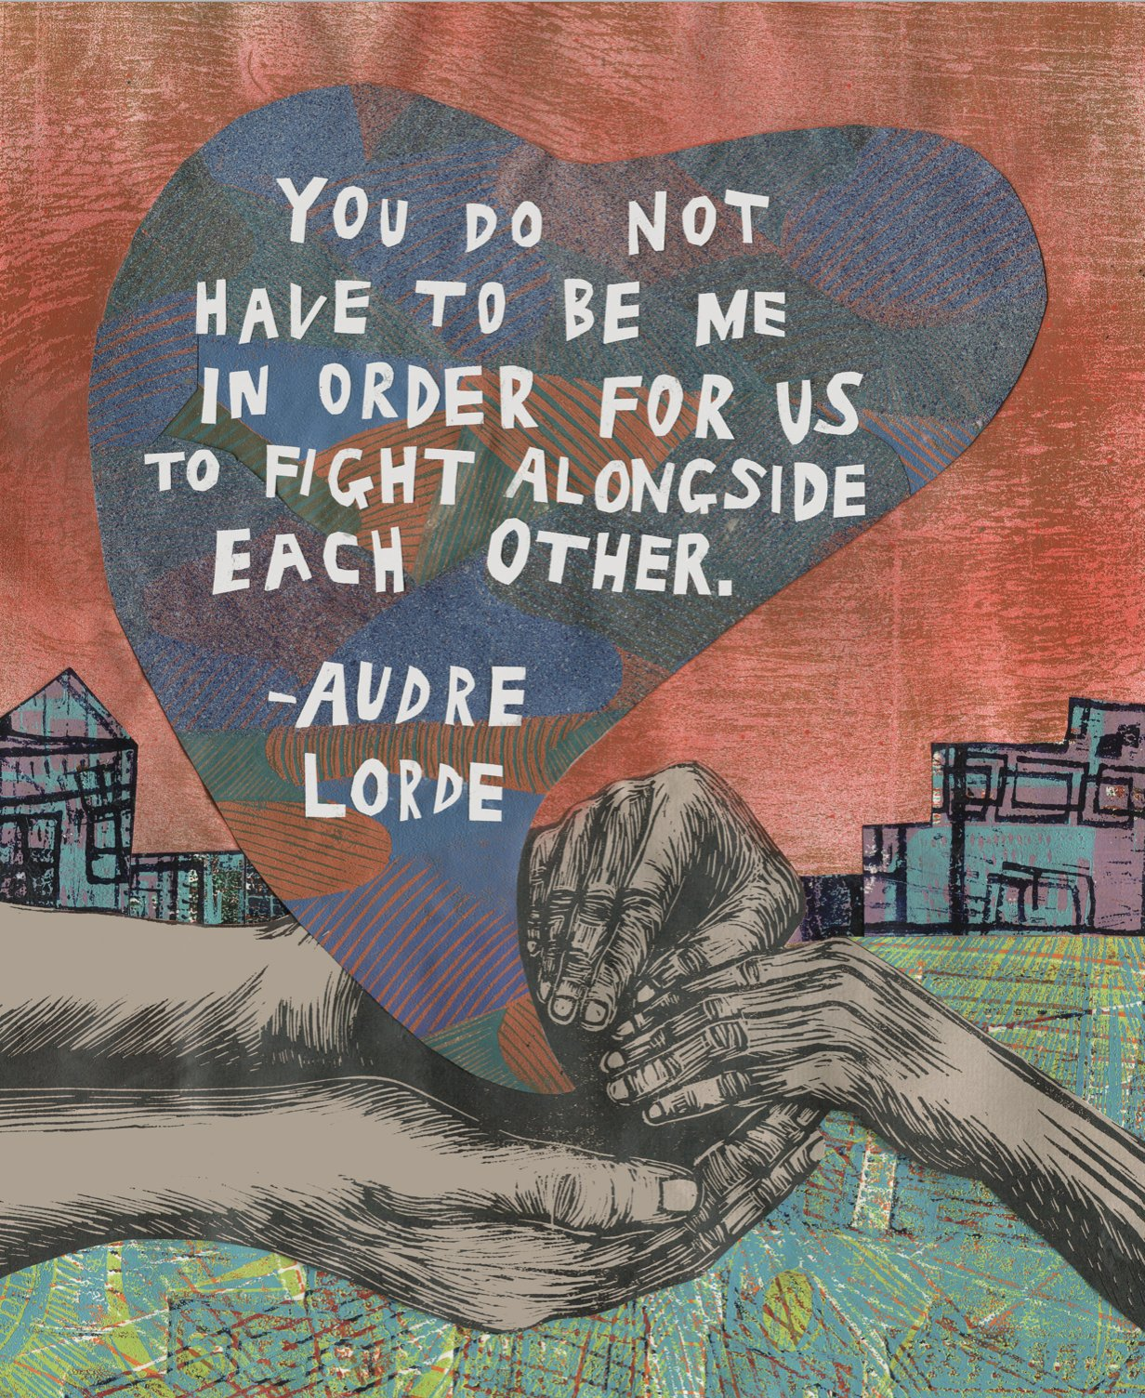
Group Exercise: Donor Profiles
Determine what steps you would take to transition these donors from crisis to mission donors
Image: Meredith Stern
Notes:
Douglas: Attendees will participate in a group activity.
Can you raise your hand if you work at an organization that has experienced an influx of donors as a result of a local or national crisis? [folx raise their hands]
The crisis can include COVID-19.
Keep your hands raised.
Ziplock bag of sticky notes and white board / posted sticky pads (get people up)

Slide 28
Transitioning Crisis Donors to Mission Donors
Thank you!
Questions & Comments?
Notes:
gap: didn’t feel racial justice specific? could apply to any organization?
george floyd was a trigger/moment for us–could be many other things that happen that function similarly to your organization
your audience is fundraisers interested in social justice
mentee online platform where you can ask questions and answers show up in word bubbles/clouds. start session by asking engaging questions that will set the tone–why are you here? have you yourself experienced this? do you personally give to racial justice organizations? help remind them of who they are and the work is important to them; why this subject matter is imperative to the work they’re doing moving forward
gives them a chance to reflect on how they want to grow as a person, as opposed to just hitting metrics for their organization. how do they want to exist in the world?
another way to bring them in–around the surprise data: “what percent of new sustainers do you think were lapsed crisis donors?” identify the shockers in your story and refer back to them as you go through
people remember stories > data. how do you get the language on the slides that they’re going to remember?
Tina remembers the language “just city”--how does this organization get us there? this is why this organization is important; this is why donors feel connected to this
more examples of how donors are reacting (social proof) > making assumptions about how donors want to be treated. enjoyed the testimonial. provides a clear picture of the importance of the work
“we are guided by the belief of…” listed a lot of things. would like to see that language on the slides. immediately prompts the listener to consider if they believe they work they are doing
summary slides: could have a diagram as opposed to only text to mix it up a bit
only slide frankie remembers: picture of girl holding sign–visual impact
michelle: less is more–just impactful items on each slide
slide on retention rates
what stuck with tina: (1) fundraising that aligns with your values (2) understanding a crisis and how it relates to the work–have to be an expert in the content of your org (3) internal culture rooted in stewardship–people will want a boss like Regina (4) defense/offense/dreaming prong also felt very aspirational (5) language on “no one had INTENTIONALLY thanked these donors” was a huge takeaway
Lejla to make CCF part more explicitly connected to racial justice

